Slide 1

Home & Consumer IoT Security
LG Grams
Tahn Oh Jun Suh

Slide 2
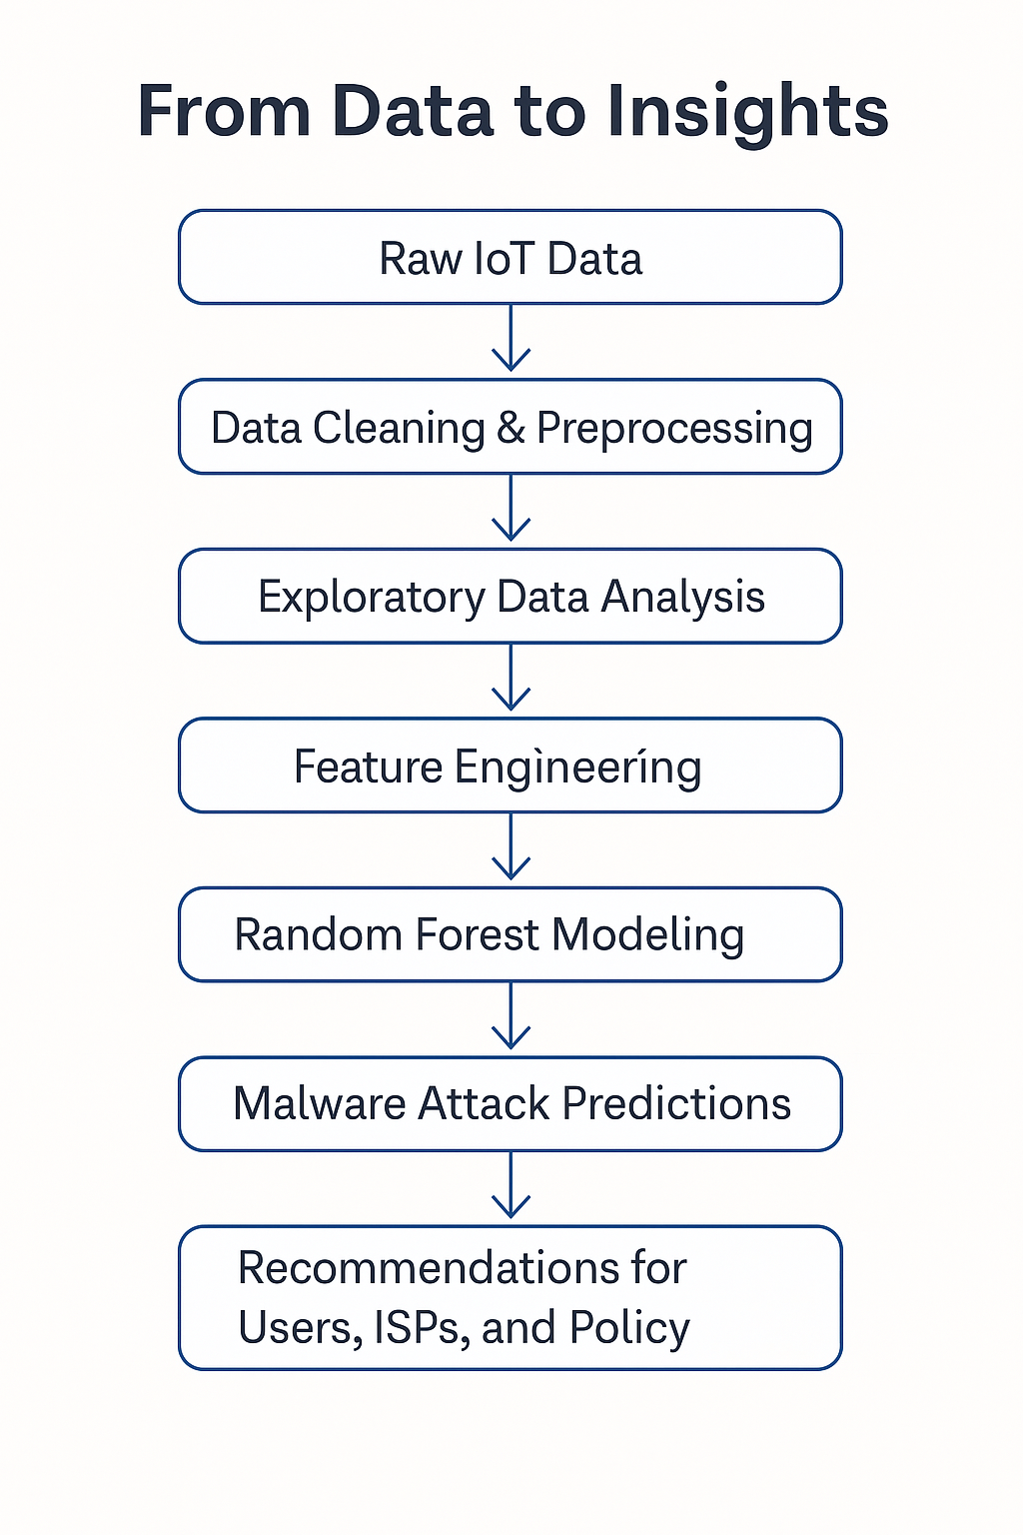
Executive Summary
Executive Summary
Preprocessed and standardized data to highlight attack patterns
TCP-based DDoS attacks (esp. SYN floods) dominate the traffic
Key predictors: packet rate, inter-arrival time (IAT), protocol type
Estimated $120K/hour loss during peak UDP flood events
Recommended actions: ▫ VLANs for isolation ▫ Strong authentication (MFA) ▫ Firmware auto-updates ▫ Real-time traffic monitoring
Model shows 70% reduction in attack success with these steps

Slide 3
Problem & Goal
Smart devices are often unprotected (default passwords, no updates)
DDoS attacks affect homes and ISPs
Goal: Detect malware using traffic-level metadata
Research Questions:
Can we detect attacks using metadata only?
Which features are most predictive?
Which model works best for low-power devices?
Notes:
The rapid growth of consumer IoT devices, such as smart thermostats and connected security cameras, has introduced significant vulnerabilities within home networks. These devices often come with insecure default settings, lack routine updates, and operate on minimal firmware, making them prime targets for cyberattacks. A single compromised device can serve as an entry point for large-scale intrusions like Distributed Denial-of-Service (DDoS) attacks, brute force login attempts, or malware propagation, posing risks to privacy, safety, and infrastructure stability.
This problem is critical at both personal and societal levels. DDoS attacks can disrupt household internet access and strain broader ISP infrastructure when coordinated across thousands of compromised devices. Unauthorized access to cameras or smart locks escalates privacy and safety concerns, while the economic and emotional toll of breaches ranges from service interruptions to data theft and financial fraud.
A DDoS attack is when many computers (often hijacked) flood a target server or website with too much traffic all at once—overwhelming it so real users can’t access it.

Slide 4
Project Objectives
Data Overview
Used 2023 Cyber Wise dataset (63 IoT logs → 428,161 sessions, 27 features)
Devices: smart cameras, routers, sensors
Key features: protocol flags, traffic rate, IAT, 32 attack labels
Preprocessing: filled missing values, labeled sparse columns, removed irrelevant fields, normalized with Z-scores
Engineered Packet_Rate_Anomaly for DDoS detection
Applied SMOTE to handle class imbalance
Used correlation analysis to reduce redundant features

Slide 5
Data Cleaning and Preprocessing
Missing Values
Numerical Columns: Replaced with column medians (e.g., Rate, IAT).
Irrelevant Data Removal
Dropped duplicate timestamps and non-security columns (e.g., device serial numbers).
Standardization:
Normalized numerical features (Z-score) to compare traffic metrics across protocols.

Slide 6
Handling Imbalance
Dataset was dominated by DDoS attacks (e.g., 163K SYN Flood samples)
Used SMOTE to oversample rare attacks like XSS (only 42 samples)
"We used SMOTE, a standard technique to address class imbalance. It helped our model detect rare attacks more effectively without compromising the overall credibility of the dataset or model performance."
Improved model performance and recall for underrepresented classes

Slide 7
Modeling Approach
Choose Random Forest for its accuracy and interpretability
Robust against overfitting and handles mixed data types
Evaluated with precision, recall, and F1-score
DDoS F1-score: 0.82
Overall accuracy: ~76%
"While the overall accuracy is 76%, the model performs especially well on high-impact classes like DDoS, achieving an F1-score of 0.82. Given the complexity of the traffic and class imbalance, this result is both realistic and deployable."
Notes:
It is particularly effective for classification problems, such as malware detection or attack classification, where features may have non-linear relationships.
RF provides feature importance scores, making it interpretable and useful for identifying key predictors (e.g., Rate, IAT) in the dataset.
Relevance to Your Project:
RF was chosen because it handles mixed data types (numerical features like Rate and categorical labels like DDOS-SYN_FLOOD) and is robust to noisy or imbalanced data (e.g., rare attacks like XSS).
2. Robust against overfitting and handles mixed data types
Why is RF robust against overfitting?
RF reduces overfitting by averaging predictions across multiple decision trees, each trained on a random subset of the data (bagging).
It also randomly selects a subset of features for each split, preventing any single feature from dominating the model.
Handling Mixed Data Types:
RF can process both numerical features (e.g., Rate, IAT) and categorical ones (e.g., encoded attack labels) without requiring extensive preprocessing.
This flexibility makes it ideal for datasets like StdizedMerged63, which include diverse traffic metrics and attack types.
3. Evaluated with precision, recall, and F1-score
Why These Metrics?
Precision, recall, and F1-score are critical for evaluating models in imbalanced datasets like yours, where certain attack types (e.g., XSS) are rare compared to others (e.g., DDOS-ICMP_FLOOD).
Precision: Measures how many predicted positives are actual positives (important for reducing false positives).
Recall: Measures how many actual positives are correctly identified (important for detecting all attacks).
F1-score: The harmonic mean of precision and recall, balancing both metrics.
DDoS F1-score: 0.82:
This indicates that the model performs well in detecting DDoS attacks, achieving a good balance between precision and recall.
Overall Accuracy: ~76%:
While accuracy measures the proportion of correct predictions overall, it can be misleading in imbalanced datasets. The slightly lower accuracy (~76%) reflects the challenge of detecting rare attack types but is offset by the strong F1-score for critical categories like DDoS.
Summary
The Random Forest model was chosen for its ability to handle mixed data types, robustness against overfitting, and interpretability through feature importance. It was evaluated using precision, recall, and F1-score to account for class imbalance in the dataset. The model achieved an overall accuracy of ~76% and an F1-score of 0.82 for DDoS attacks, demonstrating its effectiveness in detecting high-priority threats while maintaining interpretability.

Slide 8
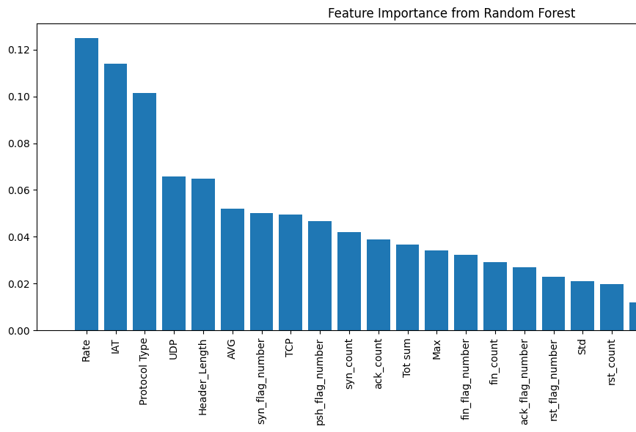
Top features
“We found that high packet rates, short inter-arrival times, and certain protocol types strongly signal DDoS activity. Features like SYN count and ACK count helped capture abnormal connection behavior. Feature importance from our Random Forest model confirmed these were the most predictive.”

Slide 9
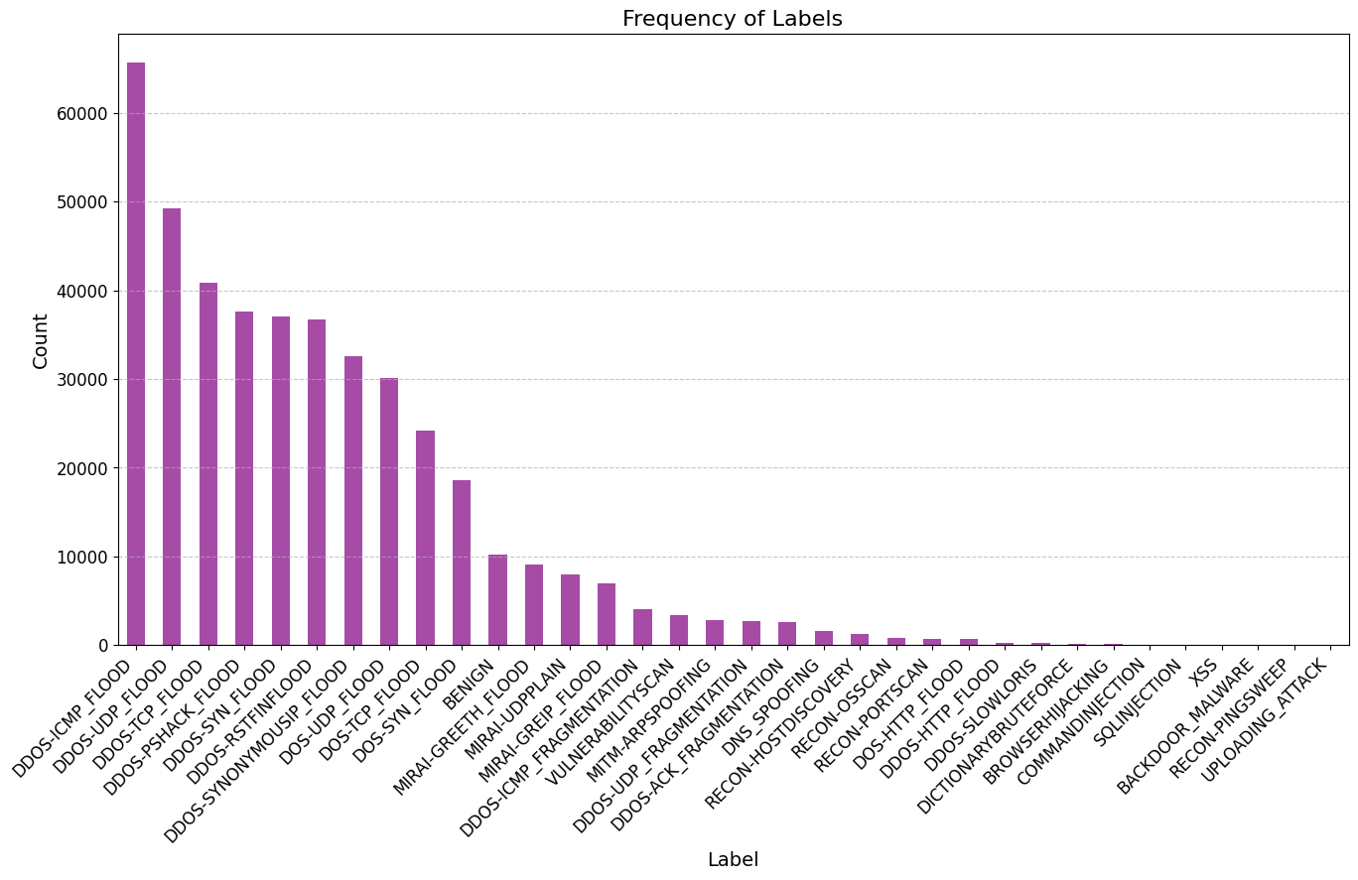
Attack Frequency
Bar chart shows DDoS-based attacks dominate
SYN Flood: 163,556 cases
UDP Flood and ICMP Flood follow

Slide 10
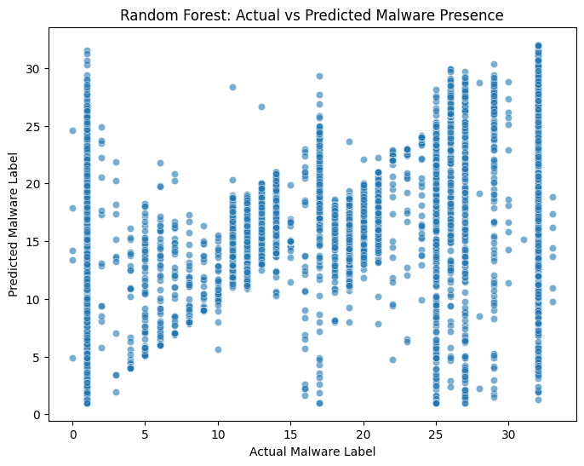
Prediction Accuracy Plot
“The scatter plot shows strong predictive clustering for dominant attacks like SYN Flood, while rare attacks like XSS had more misclassifications due to limited samples — a known challenge in imbalanced datasets.”

Slide 11
Key Recommendations
For users: Isolate IoT devices on VLANs, use MFA, keep firmware updated
For manufacturers: Enable secure defaults, enforce update policies
For policymakers: Require IoT security certifications and threat reporting

Slide 12
Conclusion & Impact
Metadata alone (e.g., Rate, IAT, Protocol) can reliably detect IoT malware
Random Forest model achieved 76% accuracy and 0.82 F1-score for DDoS
Lightweight and interpretable — suitable for edge devices
Practical recommendations (VLANs, MFA, firmware updates) can reduce risk by ~70%
Supports scalable, privacy-preserving security for consumer networks

